Slide 1
Transaction Approval Rules
29 August 2011
Notes:
Transaction approval rules - <number>
Guidewire training materials contain Guidewire proprietary information that is subject to confidentiality and non-disclosure agreements. You agree to use the information in this manual solely for the purpose of training to implement Guidewire software solutions. You also agree not to disclose the information in this manual to third parties or copy this manual without prior written consent from Guidewire. Guidewire training may be given only by Guidewire employees or certified Guidewire partners under the appropriate agreement with Guidewire.

Slide 2
Lesson objectives
By the end of this lesson, you should be able to:
  Describe how transactions are approved
  Describe how authority limits are used to check if approval is required
  Write transaction approval rules that check if approval is required
  Write approval routing rules
  This lesson uses the notes section for additional explanation and information.
  To view the notes in PowerPoint, choose View→Normal or View→Notes Page.
  If you choose to print the notes for the lesson, be sure to select “Print hidden slides.”
Notes:
Transaction approval rules - <number>

Slide 3
Lesson outline
Transaction approval basics
Authority limits
Transaction approval rules
Approval routing rules
Notes:
Transaction approval rules - <number>

Slide 4
Review: Transaction rules
(unique to setup)
(used during and outside setup)
Pre-setup
Pre-update
Approval
Post-setup
Validation
Appr. routing
Approval rules determine if transactions (and/or checks) require approval
If approval is needed, approval routing rules route approval activity to person whose approval is needed
Notes:
Transaction approval rules - <number>
Approval rules are run when a transaction is created and when it is edited or approved. (A transaction might require multiple approvals. Therefore, approval rules are run even when a transaction is approved.)
Approval routing rules are run whenever a transaction is designated as requiring approval.
There is no "Check approval" rule set. This is because the Transaction approval rule set is intended to cover both transactions and checks. Keep in mind that:
The root entity for all transaction rule sets is TransactionSet.
The TransactionSet entity has a CheckSet subtype.
The CheckSet subtype has a Checks array which points to the Check entity.
In other words, every check is associated with a transaction set.

Slide 5
TransactionSet approval process
Submitting User
Set status to "Pending approval"
Create and route approval activity
Requires approval?
yes
Transaction
Set
no
Set status to "Submitting"/
"Awaiting Submission"
Approval process initiated whenever transaction is created or changed
Notes:
Transaction approval rules - <number>
Once a user submits (saves) a transaction, a decision process is initiated to determine if rules or authority limits require approval and if so, who should perform the first level of approval. Subsequent slides discuss each possible step and path in the decision tree.

Slide 6
Transaction approval
Transaction is always submitted by a user who may or may not have configured authority limits
Each transaction in the set may be tested against some authority limit or business rule
Approval always occurs at the TransactionSet level
  Either all transactions in set are approved or none are approved
Submitting User
txn1
Transaction
Set
txn2
txn3
TransactionSet
Requires approval
Notes:
Transaction approval rules - <number>
The primary purpose of the transaction approval process is determine if a transaction can be acted on immediately or if it must be approved by someone of sufficient authority. In the base application, no other object requires this type of approval. This functionality is implemented only for transactions because the setting of reserves and execution of payments is typically one of the most tightly controlled activities within the claims process.
Transactions are approved or rejected as a group because one transaction often influences another. For example, a single check might involve three payment transactions from two different reserve lines. If the check requires approval, for example, for a single transaction (txn 3 in the slide) because it is for a medical procedure and it is more than 25% over the standard amount for the specified procedure, then the check and all of its payment transactions must be set to pending. If approval was at the transaction level, then there would be ambiguity as to what to do with a check which consisted of two approved payment transaction and one pending approval payment transaction.

Slide 7
Determining if approval is required
Submitting User
Set status to "Pending approval"
Create and route approval activity
Requires approval?
yes
Transaction
Set
no
Set status to "Submitting"/
"Awaiting Submission"
Two mechanisms for identifying transactions that require approval
  Authority limits
  Transaction approval rules
Configure to use either or both mechanisms
Notes:
Transaction approval rules - <number>
Authority limits and transaction approval rules are discussed in detail in this lesson.

Slide 8
If no approval is required
Submitting User
Set status to "Pending approval"
Create and route approval activity
Requires approval?
yes
Transaction
Set
no
Set status to "Submitting"/
"Awaiting Submission"
For reserve transactions, reserve lines are created or modified
For payment transactions, checks put into "awaiting submission" status
Notes:
Transaction approval rules - <number>
Recall that a check remains in "awaiting submission" status until the batch process which sends the check information to the check printing system. The next status it is set to is "requested" or "requesting", depending on the nature of the integration point to the check processing system.

Slide 9
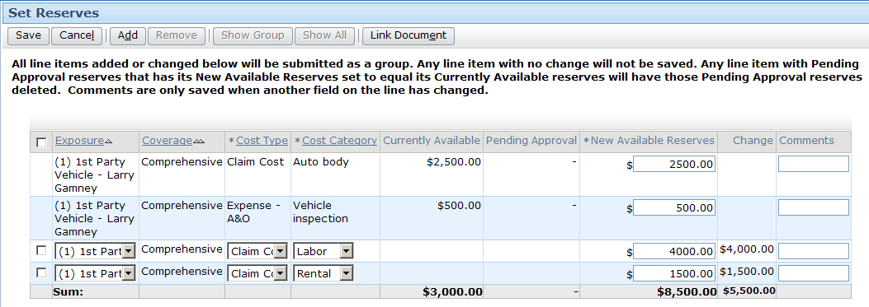
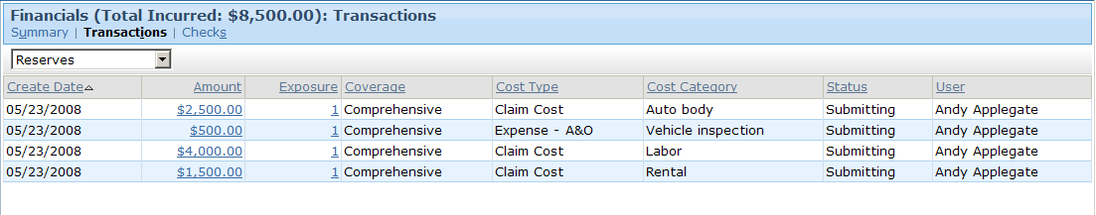
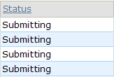
Transaction set not requiring approval
Notes:
Transaction approval rules - <number>
In the example above, a transaction set consisting of two reserve transactions is created. The transaction set does not exceed any authority limits or trigger any approval rules. Therefore, both transactions in the transaction set are listed as "Submitting".

Slide 10
If approval is required
Submitting User
Set status to "Pending approval"
Create and route approval activity
Requires approval?
yes
Transaction
Set
no
Set status to "Submitting"/
"Awaiting Submission"
TransactionSet and all transactions in it set to "pending approval"
Special approval activity created and routed according to approval routing rules
Notes:
Transaction approval rules - <number>

Slide 11
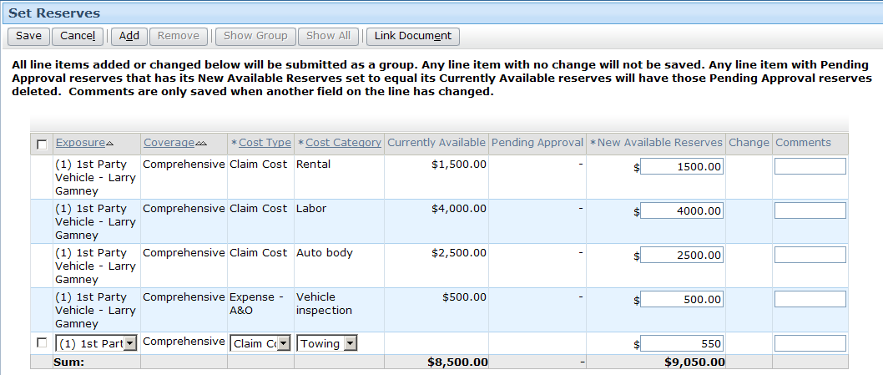
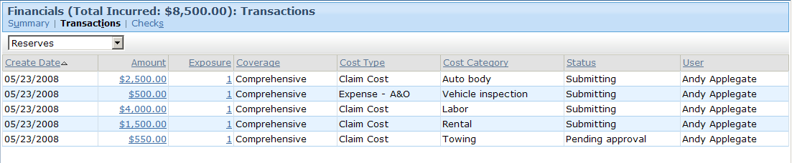
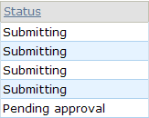
Transaction set pending approval
Notes:
Transaction approval rules - <number>
In the example above, a transaction set consisting of a single reserve transaction is created. The transaction set triggers an approval rule. Therefore, the transaction is listed as "Pending approval".

Slide 12

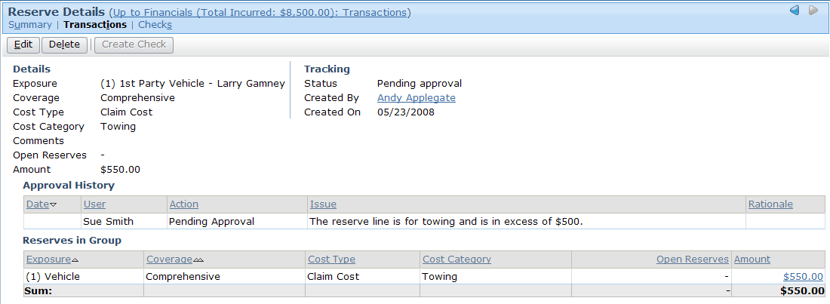

Pending approval transaction in detail
Notes:
Transaction approval rules - <number>
To view detailed information about a transaction, click the link in the transaction list Amount column.
If multiple transactions are in a set they are shown separately.
The approval history of the transaction appears in the approval History list. note the issue column, which includes text from the transaction rule. This text would contain multiple causes if more than one transaction contributed to requiring the approval.

Slide 13
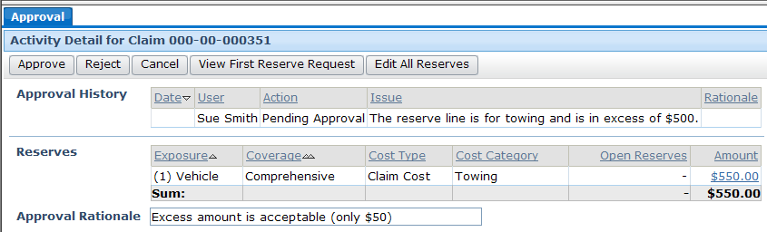
Transaction approval activity
Approve / reject buttons
Approval History list
Approval Rationale
Approval activities are special type of activity unique to transaction approval
Notes:
Transaction approval rules - <number>
Transaction approval activities are unlike regular activities in the following ways:
They are not closed by being skipped or completed. Instead, they are approved or rejected.
They have toolbar buttons, list views, and a rationale field specific to the act of approving financial transactions.
They are routed not by activity assignment rules but rather by approval routing rules.
View First reserve request button opens a popup with the first transaction in the set.

Slide 14
Rejection of TransactionSet
Transaction set approved?
no
Set
status to "Rejected"
yes
Submitting User
Set status to "Pending approval"
Create and route approval activity
Requires approval?
yes
Transaction
Set
no
Set status to "Submitting"/
"Awaiting Submission"
When set is rejected, transactions remain in system but no further action is taken
Notes:
Transaction approval rules - <number>
The first time the TransactionSet is submitted, it carries with it the submiting user.
Once routed for approval, the approving user is associated with the TransactionSet and her limits are used to determine if it requires approval again.

Slide 15
Approval of TransactionSet
Transaction set approved?
no
Set
status to "Rejected"
yes
Last approving User
Set status to "Pending approval"
Create and route approval activity
Requires approval?
yes
Transaction
Set
no
When set is approved, approval rules re-executed using permissions of last approving user
  Allows multi-stage approval
Set status to "Submitting"/
"Awaiting Submission"
Notes:
Transaction approval rules - <number>
As an example of multi-phased approval, a carrier might have a rule which says workers' comp checks over $10,000 must be approved first by the group supervisor and then by the regional manager. If this were the case, then you would expect to see an approval rule similar to the one shown below...
Condition: (TransactionSet.Claim.LossType == "WC") AND
TransactionSet.Amount > 10000
Action: TransactionSet.requireApproval()
...and an approval routing rule similar to the one shown below...
Condition: (TransactionSet.Claim.LossType == "WC") AND
TransactionSet.Amount > 10000
Action: if LastApprovingUser = null
TransactionSet.approveByGroupSupervisor()
else"
{
// create regionalSupervisor and regionalGroup
// variables and set as appropriate
TransactionSet.setApprovingUser(
regionalSupervisor, regionalGroup)
}

Slide 16
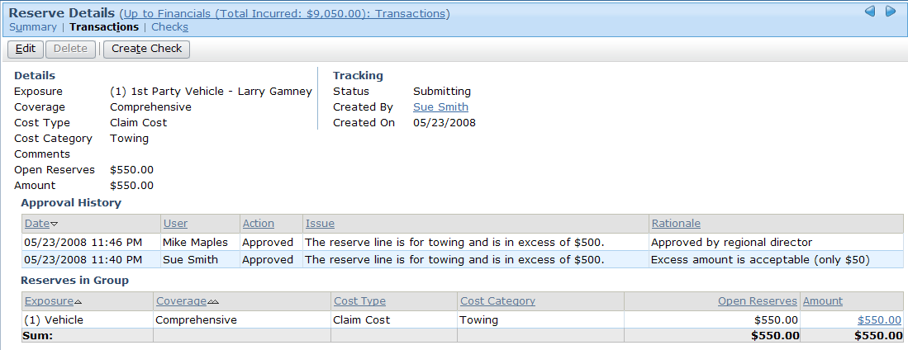

Multi-stage approval
Notes:
Transaction approval rules - <number>
If a transaction set requires multiple approvals, then each approval appears as a line in the approval History list. Note that the user, date, action, and rationale for each approval event appears in the list.

Slide 17
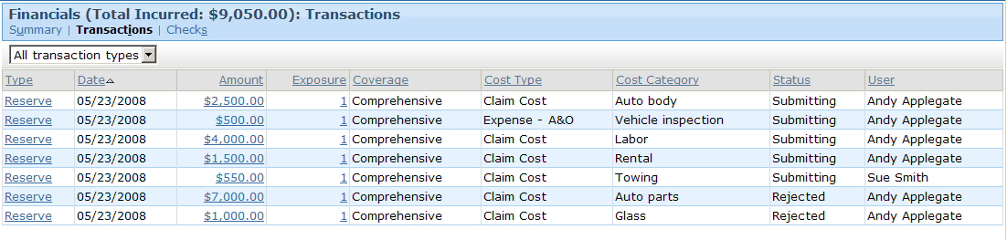
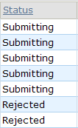
Approved and rejected transaction sets
approved
rejected
Notes:
Transaction approval rules - <number>
The example shown above shows four transaction sets. (You can identify which transactions belong to the same set only by viewing the details for each transaction.)
The first one (consisting of two reserve transactions) immediately went to Submitting without requiring approval.
The second one (consisting of two reserve transactions) required approval. Once it was approved, it went to Submitting.
The third one (consisting of one reserve transaction) required approval. Once it was approved, it went to Submitting.
The fourth one (consisting of two reserve transactions) required approval. It was not approved and went to rejected.
From the Transactions list, there is no status distinction between transactions which were immediately approved, transactions which were pending approval for authority limits reasons and then approved, or transactions which were pending approval for approval rules reasons and then approved. However, you would see differences in the Transaction Detail screen, as this lists the approval history of each transaction, if any.
Rejected transactions are obviously listed with a status of "Rejected".

Slide 18
Primary transaction approval methods
Set status to "Pending approval"
Create and route approval activity
Requires approval?
yes
Transaction approval
  transactionSet.requiresApproval()
    When executed, transaction set is flagged as
    needing approval
Approval routing rules
  transactionSet.approveByGroupSupervisor()
    Approval activity routed to supervisor of owning group
  transactionSet.setApprovingUser()
    Approval activity routed to specified user
Notes:
Transaction approval rules - <number>
All three methods are discussed later in this lesson.

Slide 19
Lesson outline
Transaction approval basics
Authority limits
Transaction approval rules
Approval routing rules
Notes:
Transaction approval rules - <number>

Slide 20
Authority limits
Authority limits
Exposure
Reserves
(for Collision):
$10,000
$0K
$10K
$20K
Total
Payments:
$15,000
$0K
$10K
$20K
An authority limit is a rule which limits the transactions an adjuster can create without approval
  It consists of a criteria (such as "total payments for the entire claim") and an amount (such as $15,000)
Notes:
Transaction approval rules - <number>
An authority limit is associated to a user through an authority limit profile. This is discussed in an upcoming slide.
If an adjuster creates a transaction which meets the criteria of an associated authority limit, and the authority limit threshold is exceeded, then the transaction is immediately placed in a state of "pending approval" and an activity is generated and (typically) assigned to the supervisor of the group to approve or reject the transaction.
Authority limits can be tied to any type of transaction. They can be tied to a single exposure, a single payment, the entire claim, or a change in the size of the reserve line. They can be associated to a specific coverage. They can be associated to a specific cost type.

Slide 21
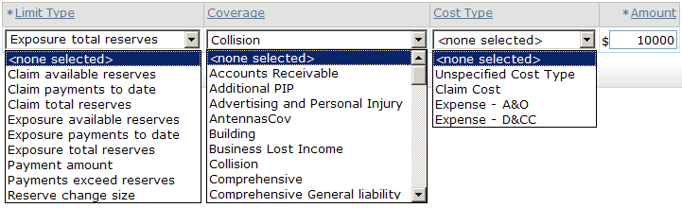
Authority limit options
Criteria
Amount
Each criteria is a combination of:
  A predefined limit type
  An optional coverage
  An optional cost type
Each limit is a criteria plus an amount
Notes:
Financials Approval - <number>
The options available in the Limit Type list cannot be modified: it maps to the AuthorityLimitType typelist, which is an internal (and therefore unmodifiable) typelist.
The Coverage and Cost Type lists can be modified.

Slide 22
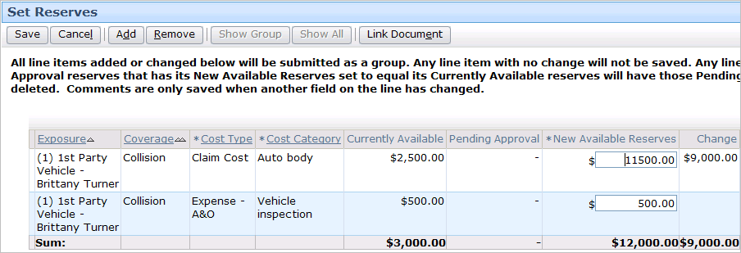
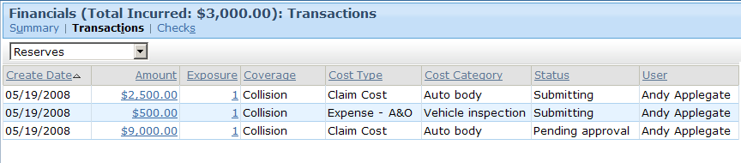
Exceeding an authority limit
Transaction will increase exposure total reserves for collision to over $10000
Notes:
Financials Approval - <number>
When a transaction exceeds an authority limit, the transaction is saved, but the status is set to "Pending approval". From a financials standpoint, no further action is taken on the transaction until it is approved.

Slide 23
Authority limit profiles
Adjuster profile
Exposure
Reserves
(for Collision):
$10,000
Dana Evans
$0K
$10K
$20K
Total
Payments:
$15,000
Peter Beebe
$0K
$10K
$20K
An authority limit profile is a collection of authority limits assigned to one or more users
  Can be pre-defined (created once and shared across multiple users)
  Can be custom (created for a single user)
Notes:
Transaction approval rules - <number>
An authority limit profile is a set of limits that specify threshold amounts for one or more types of transactions. When an authority limit profile is associated with a given user, if that user creates a transaction of a type listed in the profile which is at or exceeds the threshold amount, then the transaction is marked as requiring supervisor approval.
In the example above, if either Dana Evans or Peter Beebe creates a reserve transaction for an exposure tied to collision coverage and the amount is over $10,000, then the transaction will require approval. Also, if either Dana Evans or Peter Beebe creates any type of reserve transaction that causes the total reserves for the claim to exceed $15,000, then the transaction will require approval.
Technically speaking, there is an entity used by ClaimCenter for financials processing known as a transaction set. Every transaction belongs to a transaction set. Transaction sets can have one or multiple transactions in them. approval occurs at the transaction set level. If one transaction in the set requires approval, then the entire set requires approval. If the supervisor accepts the transaction, then the entire transaction set is accepted. If the supervisor rejects the transaction, then the entire transaction set is rejected. In practice, this level is typically transparent to an end user and is not discussed in detail here.

Slide 24
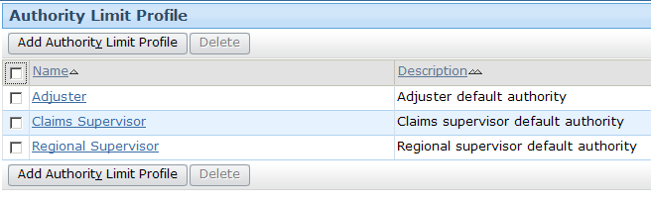
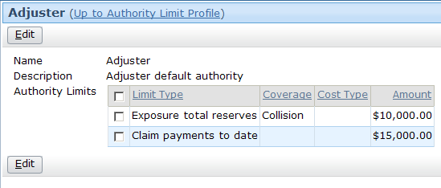
Creating pre-defined profiles
Notes:
Transaction approval rules - <number>
Pre-defined authority profile limits can be shared across multiple users. They are created and configured from the Administration tab's authority limit profiles screen.
To configure an existing profile, click the profile name, click the Edit button, and add, remove, or modify limits as needed.
To create a new profile, click the Add authority limit profile button. Then add limits as needed.

Slide 25
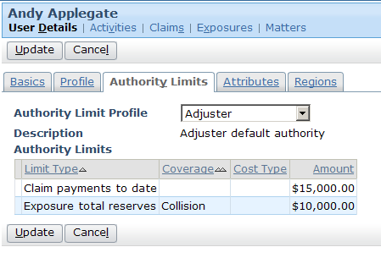
Assigning pre-defined profiles to users
Each user can have at most one authority profile
  Profile is assigned through the User screen
Notes:
Transaction approval rules - <number>
To assign a pre-defined profile to a user, select the profile from the authority limit profile dropdown. note that when you choose a profile, the limits of the profile appear but are read-only. You cannot modify a pre-defined profile at the user level. You can modify it only at the profile level (which means the change you make will affect all users associated with that profile).

Slide 26
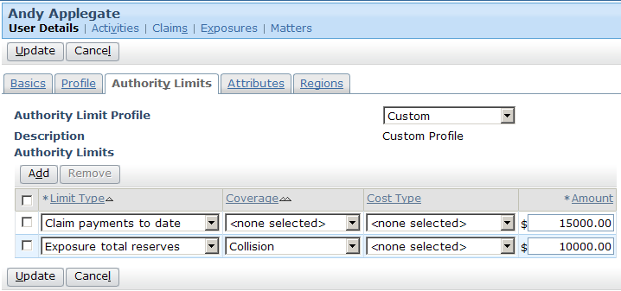
Assigning custom profiles to users
Can also assign a custom profile to a user
  Specifies set of authority limits that are not shared with other users
Notes:
Financials Approval - <number>
You can create a custom profile by selecting Custom from the Authority Limit Profile dropdown. Once you select Custom, the Authority Limit list becomes editable. Any custom profile created for a user is unique for that user. It cannot be applied to other users (unless you manually recreate it for the next user), and any changes to a given custom profile have no affects on any other profile.

Slide 27
Lesson outline
Transaction approval basics
Authority limits
Transaction approval rules
Approval routing rules
Notes:
Transaction approval rules - <number>

Slide 28
Transaction approval, approval routing
Transaction approval rules implement approval logic that cannot be captured in an authority limit, such as
  Logic beyond the given limit types
  Logic tied to attributes other than coverage and cost type
  Logic that cannot easily be associated to given users
Approval routing rules assign approval ownership
Notes:
Transaction approval rules implement approval logic that cannot be captured in an authority limit, such as
Logic beyond the given limit types
Logic tied to attributes other than coverage and cost type
Logic that cannot easily be associated to given users
Transaction approval rules - <number>

Slide 29
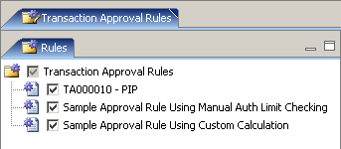
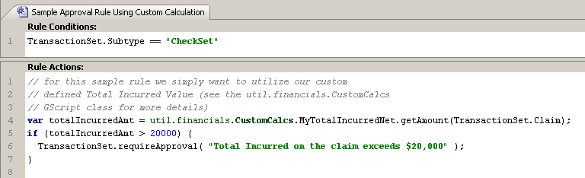
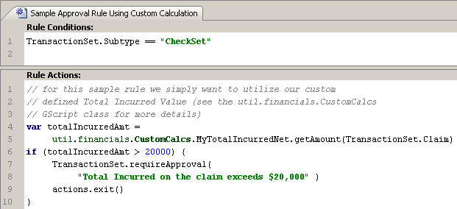
Transaction approval rules
Typically, all (relevant) rules are executed
  The cause for additional approvals will be added to the approval activity
Notes:
Transaction approval rules - <number>
A transaction set either requires approval or does not require approval. However, there could be additional causes that the approving supervisor should know about. By executing all rules, the approval activity will contain a list of all limits that have been exceeded.

Slide 30
The requireApproval method
Syntax: transactionSet.requireApproval("reason")
  Method only on transactionSet (not Transaction or Check)
Notes:
Transaction approval rules - <number>
In the example above:
The condition checks to see if the transaction set is a check set.
In the rule actions, lines 4 and 5 create a variable and set it to the total incurred amount of the claim.
Line 6 checks to see if the total incurred amount is greater than 20000. If it is...
Line 7 identifies that the transaction set requires approval and specifies the string to be used for the reason. This string appears both in the approval activity (which is seen by the supervisor) and in the transaction detail view (which any user with access to the claim can see by selecting the transaction from the transaction list).

Slide 31
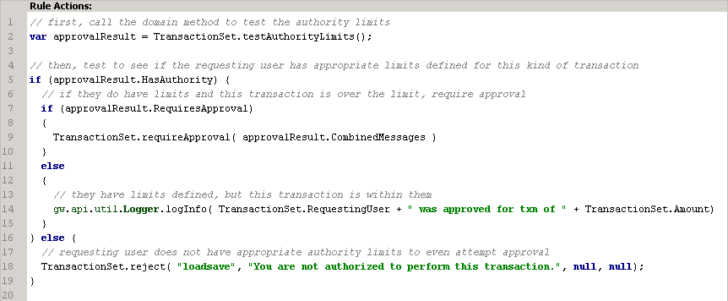
Manual evaluation of authority limits
You can perform authority limit checking for transactions by
  setting CheckAuthorityLimits to false in config.xml
  writing selective rules that perform “manual” checks for users’ authority limits and reject or require approval
  writing default rules that perform checking against limits for all other transactions
Notes:
Transaction approval rules - <number>
Authority
The screenshot from above is a slightly enhanced version of the rule action of the Sample approval rule Using Manual auth limit Checking rule in the sample data. The example is meant to illustrate that some customers may want to configure the system to not do automatic authority limit checks for every check during the approval process because they use the Bulk Pay feature and don't want these tests run on bulked checks.
To use a rule like the example, you have to turn CheckAuthorityLimits to false in config.xml.
This rule would have a condition that tested for the kind of transaction that you wanted to perform selective approval for, e.g. checks in bulk payments
If you want to check approval, you need to
(a) see if any limits are configured that would apply
(b) would they be exceeded i.e. would the user fail for the current transactionset and if so
(c) the reasons for the failure.
The object returned by TransactionSet.testAuthorityLimits() (for example, approvalResult) has 3 properties than can be used to do this:
HasAuthority (boolean) true if limits do exist for this type of transaction
RequiresApproval (boolean) true if the transaction is more than the limit
CombinedMessages (string) contains the list of reasons it failed
Note that if there are no limits configured for a user, you probably don't grant approval. If there are limits and they pass, then you fall through to the next rule or approval is simply not required.

Slide 32
Lesson outline
Transaction approval basics
Authority limits
Transaction approval rules
Approval routing rules
Notes:
Transaction approval rules - <number>

Slide 33
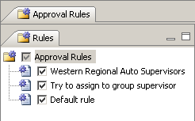
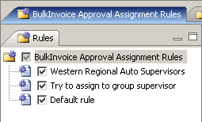
Approval routing rules
Approval routing akin to assignment for approval activities
One set of rules for transaction set approval routing, and one for bulk invoice approval routing
Typically, all (relevant) rules are not executed
  As soon as one rule makes assignment, execution exits out of rule set
Notes:
Transaction approval rules - <number>
Once you identify and succeed in routing to a user, you want to exit the rule set to avoid another rule routing to a less appropriate user.

Slide 34


Approval routing methods
Syntax: transactionSet.approveByGroupSupervisor()
  No parameters; routed to supervisor of owning group
  Returns false if user needing approval is group supervisor
Syntax: transactionSet.setApprovingUser(user, group)
  Routed to specified user and specified group
Notes:
Transaction approval rules - <number>
The approveByGroupSupervisor method returns a boolean. The value is true if the user who initiated the action that requires approval is not the group supervisor. The value is false if the user who initiated the action that requires approval is the group supervisor. This return value can be used to prevent the approval from falling into an infinite loop. (For example, imagine that Sue Smith is a group supervisor, and she is limited to creating payments up to but not over $50,000. Also, imagine that the approval routing rule routes all payments needing approval to the group supervisor. If Sue creates a check for $51,000, she will exceed her authority limit. An approval activity gets created and routed to her (as the group supervisor). She approves the activity. Then ClaimCenter re-executes the approval rules, and it sees that Sue is limited to payments up to but not over $50,000. So, it creates a second approval activity, which also gets routed to Sue. no matter how many times she approves the activities, she will always be exceeding her limits, which perpetually keeps the payment in pending approval. The better approach would be to check the return value of approveByGroupSupervisor() and, when it returns false, route the approval activity to someone other than the group supervisor who will be able to approve the activity.

Slide 35

Approval routing and group hierarchy
Routing of approvals is entirely configured –
  Without effective routing, approvals will always fail
Configure approval routing to use the group hierarchy
  Requires setting appropriate authority limit profiles for all Group Supervisors
Notes:
Transaction approval rules - <number>
If approval routing rules do not exist or fail to find a user to route to, all transactions requiring approval will fail.
To use the hierarchy, that is, to always route to the supervisor of the parent group, you can use the TransactionSet’s LastApprovingUser to identify a possible parent group and route to its supervisor.
GroupUsers is the array of linked Groups to which the user belongs - it identifies its group by the FK Group.
Although the last approving user could be a member of multiple groups, we assume for the purposes of this configuration that any of their groups will have a parent containing a supervisor with appropriate limits.

Slide 36

Exiting out of approval routing rules
Once object is successfully assigned, you typically want no other rules to be executed
  Approval routing methods are boolean – return true if the assignment was successful
  Otherwise, fall through to a default assignment rule
Notes:
Transaction approval rules - <number>

Slide 37
Lesson objectives review
You should now be able to:
  Describe how transactions are approved
  Describe how authority limits are used to check if approval is required
  Write transaction approval rules that check if approval is required
  Write approval routing rules
Notes:
Transaction approval rules - <number>

Slide 38
Review questions
For each of the following, identify the set or sets of transaction rules being described.
  Pre-setup/post-setup rules
  Pre-update rules
  Validation rules
  They are run when a transaction is created.
  They are run when a payment is modified.
  They use the reject() method.
  They use a method which creates a special type of activity.
  They have TransactionSet as the root entity.
  They perform a function similar to authority limits.
  They typically include the line "actions.exit()".
  Approval rules
  Approval routing rules
Notes:
Transaction approval rules - <number>
Answers
1. All of them.
2. All of them except for pre-setup and post-setup, which are exclusive to transaction creation.
3. Validation
4. Approval
5. All of them.
6. Approval
7. Approval routing

Slide 39
Notices
Copyright © 2001-2011 Guidewire Software, Inc. All Rights reserved.
Guidewire, Guidewire Software, Guidewire ClaimCenter, Guidewire PolicyCenter, Guidewire BillingCenter, Guidewire reinsurance Management, Guidewire ContactManager, Guidewire Vendor Data Management, Guidewire Client Data Management, Guidewire InsuranceSuite, Guidewire ContactCenter, Guidewire Studio, Gosu, Deliver Insurance Your Way, and the Guidewire logo are trademarks or registered trademarks of Guidewire Software, Inc. in the United States and/or other countries.
This material is Guidewire proprietary and confidential. The contents of this material, including product architecture details and APIs, are considered confidential and are fully protected by customer licensing confidentiality agreements and signed non-Disclosure Agreements (NDAs).
This file and the contents herein are the property of Guidewire Software, Inc. Use of this course material is restricted to students officially registered in this specific Guidewire-instructed course, or for other use expressly authorized by Guidewire. replication or distribution of this course material in electronic, paper, or other format is prohibited without express permission from Guidewire.
    Guidewire products are protected by one or more of the following patents: U.S. Patent no. 7,885,831; U.S. Patent no. 7,788,296.
Notes:
Introduction to Guidewire Configuration - <number>

